Slide 1
Seeing the invisible Ezekiel 1:1-28

Slide 2
Seeing the invisible Ezekiel 1:1-28
A surprising 30th birthday

Slide 3
Seeing the invisible Ezekiel 1:1-28
A surprising 30th birthday
An amazing vision

Slide 4
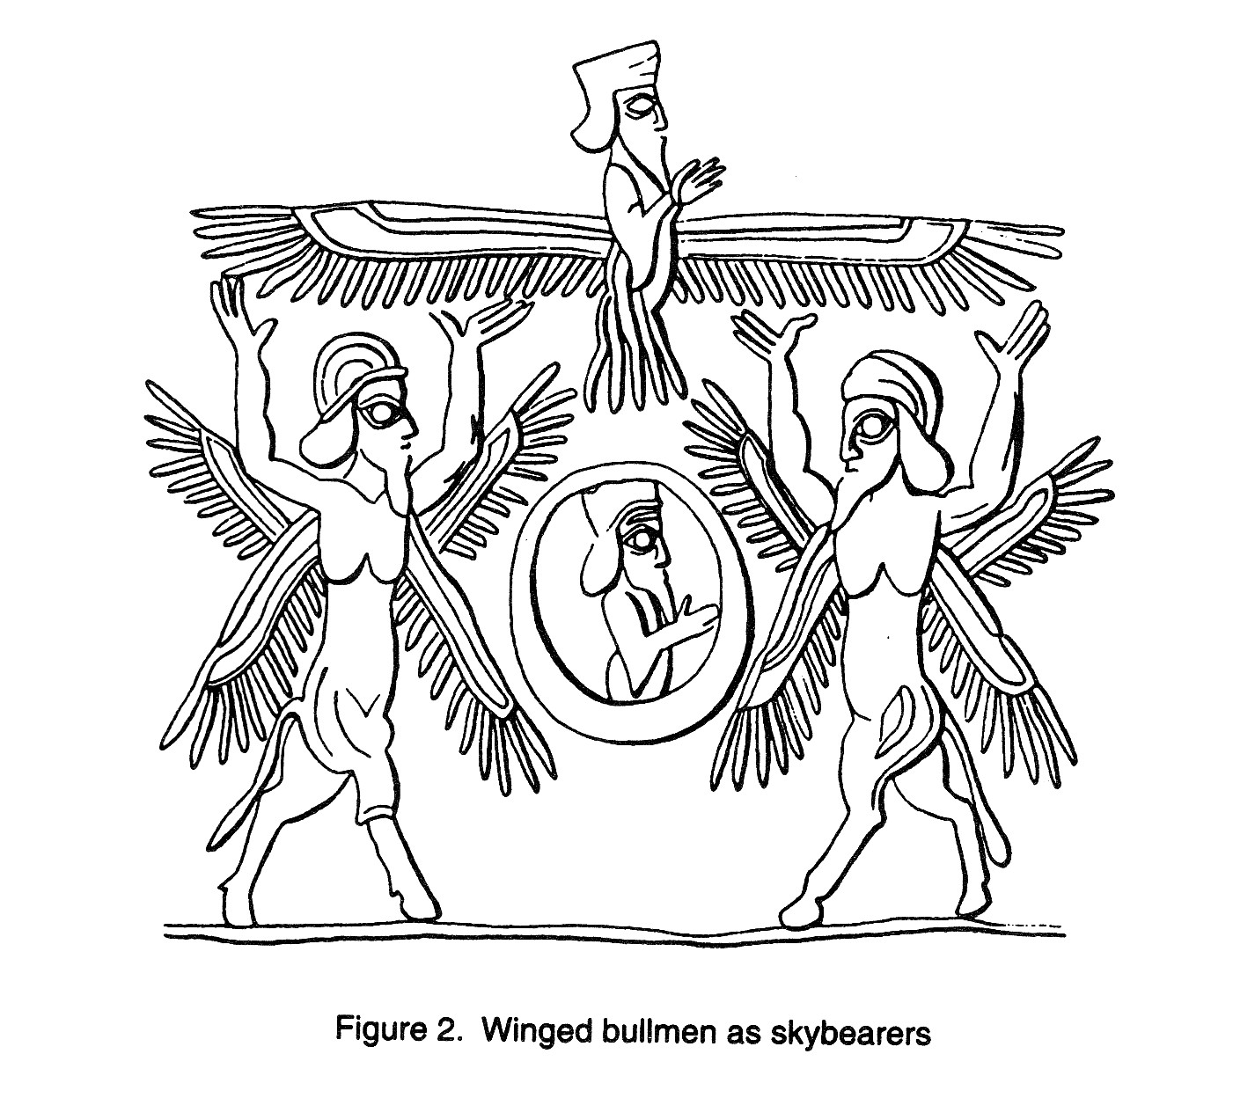
Seeing the invisible Ezekiel 1:1-28
A surprising 30th birthday
An amazing vision
Artist’s reproduction of Persian throne imagery

Slide 5
Seeing the invisible Ezekiel 1:1-28
A surprising 30th birthday
An amazing vision
Artist’s reproduction of Persian throne imagery
Visions and imagery

Slide 6
Seeing the invisible Ezekiel 1:1-28
The storm from the north (v.4)

Slide 7
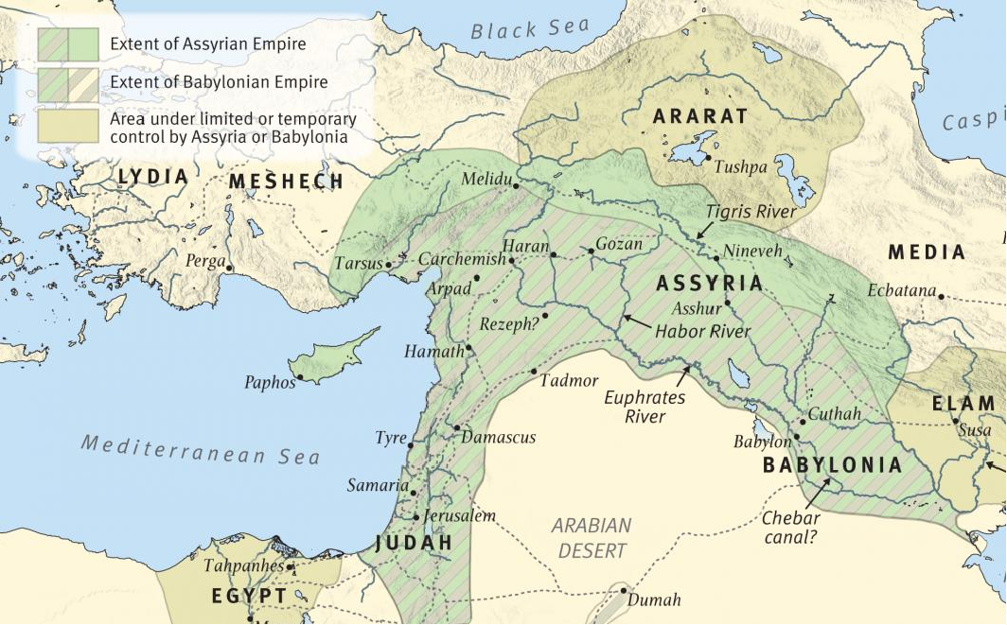
Seeing the invisible Ezekiel 1:1-28
The storm from the north (v.4)

Slide 8
Seeing the invisible Ezekiel 1:1-28
The storm from the north (v.4)
The four creatures (vv.5-9)

Slide 9
Seeing the invisible Ezekiel 1:1-28
The storm from the north (v.4)
The four creatures (vv.5-9)
All directions

Slide 10
Seeing the invisible Ezekiel 1:1-28
The storm from the north (v.4)
The four creatures (vv.5-9)
The four faces (vv.10-14)
Four faces = human, lion, ox, eagle

Slide 11
Seeing the invisible Ezekiel 1:1-28
The storm from the north (v.4)
The four creatures (vv.5-9)
The four faces (vv.10-14)
Four faces = human, lion, ox, eagle
God is sovereign over all creation

Slide 12
Seeing the invisible Ezekiel 1:1-28
The storm from the north (v.4)
The four creatures (vv.5-9)
The four faces (vv.10-14)
The wheels (vv.15-21)

Slide 13
Seeing the invisible Ezekiel 1:1-28
The storm from the north (v.4)
The four creatures (vv.5-9)
The four faces (vv.10-14)
The wheels (vv.15-21)
Empowered by the Spirit

Slide 14
Seeing the invisible Ezekiel 1:1-28
The storm from the north (v.4)
The four creatures (vv.5-9)
The four faces (vv.10-14)
The wheels (vv.15-21)
The throne (vv.22-28)

Slide 15
Seeing the invisible Ezekiel 1:1-28
The storm from the north (v.4)
The four creatures (vv.5-9)
The four faces (vv.10-14)
The wheels (vv.15-21)
The throne (vv.22-28)
Conclusion

Slide 16
Seeing the invisible Ezekiel 1:1-28
The storm from the north (v.4)
The four creatures (vv.5-9)
The four faces (vv.10-14)
The wheels (vv.15-21)
The throne (vv.22-28)
Conclusion
Three lessons

Slide 17
Seeing the invisible Ezekiel 1:1-28
The storm from the north (v.4)
The four creatures (vv.5-9)
The four faces (vv.10-14)
The wheels (vv.15-21)
The throne (vv.22-28)
Conclusion
Three lessons
God’s glory is unlimited

Slide 18
Seeing the invisible Ezekiel 1:1-28
The storm from the north (v.4)
The four creatures (vv.5-9)
The four faces (vv.10-14)
The wheels (vv.15-21)
The throne (vv.22-28)
Conclusion
Three lessons
God’s glory is unlimited
God’s judgment is unavoidable

Slide 19
Seeing the invisible Ezekiel 1:1-28
The storm from the north (v.4)
The four creatures (vv.5-9)
The four faces (vv.10-14)
The wheels (vv.15-21)
The throne (vv.22-28)
Conclusion
Three lessons
God’s glory is unlimited
God’s judgment is unavoidable
God’s blessings should not to be taken for granted

